Slide 1
Disclaimer
All J05s featured in this presentation are entirely fictional. Any similarity to any other J05, current or historical, is entirely coincidental.

Slide 2
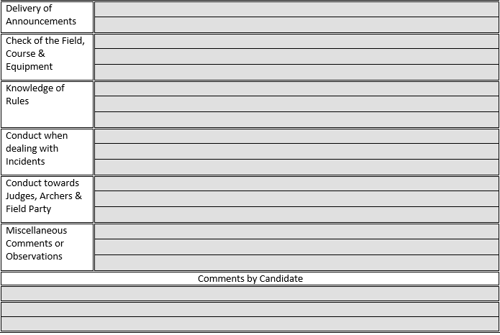
Good
Good
Good
Good
Good
Good

Slide 3
See yesterday

Slide 4
Purpose of J05s
Record of Shoots
- Keep a count of how many shoots you have done
To improve your judging
- Effective feedback

Slide 5
Giving Useful Feedback
Be specific – Focus on what actually happened during the shoot.
Be positive – Say what went well
Be constructive – We all want to get better, we just need to know HOW
Read previous J05s – there’s a reason we are supposed to hand them over at the beginning of the day

Slide 6
N/A

Slide 7
Deb did not make any announcements today

Slide 8
Deb did not make any announcements today as there was a DoS who made all necessary announcements.

Slide 9
Deb did not make any announcements today as this was a big event and she was a little nervous.

Slide 10
Deb did not make any announcements today as this was a big event and she was a little nervous. Try writing a few possible announcements so that you are ready to make at least one if you are called on.

Slide 11
Despite being nervous, Deb did make one announcement today. This still needs practice, but is a good improvement.

Slide 12
Clear and easy to hear.

Slide 13
Clear and easy to hear. Try using written notes to make sure you cover everything in your assembly speech.

Slide 14
Took part in the check of the field.

Slide 15
Accurately measured the field, including checking the field was square, and answered questions on correct tolerances.

Slide 16
Assisted with the measuring of the distances. Was a little unsure on correct tolerances for different distances.

Slide 17
Assisted with the measuring of the distances. Was a little unsure on correct tolerances for different distances. Remember to check these before a shoot.

Slide 18
Helped to check archers’ equipment, and explained to new archers what was being checked and why.

Slide 19
Helped to check archers’ equipment. Answered questions about what was being checked and why.

Slide 20
Good knowledge

Slide 21
Evidence of good knowledge of AGB rules through discussion with other judges and questions asked to a candidate judge.

Slide 22
Evidence of good knowledge of AGB rules through discussion with other judges and questions asked to a candidate judge. Remember to revise the differences between WA and AGB rules.

Slide 23
No incidents.

Slide 24
There were no major incidents during the shoot, but Deb’s conduct during regular incidents was exactly as we would expect, including when checking arrow values and making corrections at the target.

Slide 25
There were no major incidents during the shoot. Remember correct procedures during general incidents

Slide 26
I feel I learnt a lot today, especially about using a new timing system as DoS

Slide 27
I agree with the comments about my announcements. I plan to go and practice before my next shoot.

Slide 28
I feel the comments on this J05 are a little unfair as I wasn’t given the opportunity to show what I know.

Slide 29
Summary
Remember its about improving judging
Refer back to previous J05s
Writing a good J05 is tricky – delegate – it gives newer judges a chance to practise
J05’s are everyone’s responsibility – we all want to improve the standard of judging.

